Slide 1
Explorathon 2020
Using Computer Science to Make Games

Slide 2



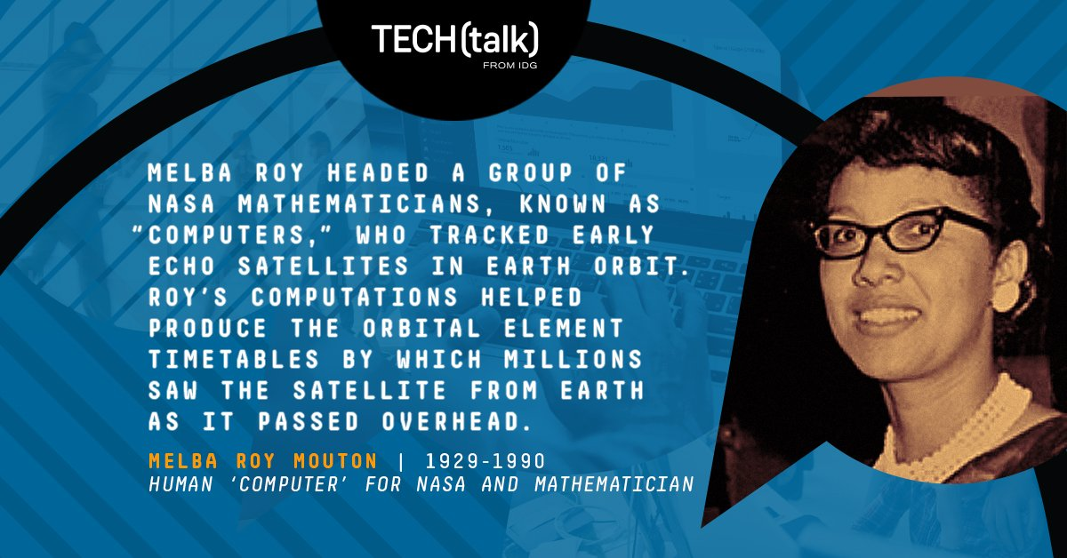
Women in Computer Science

Slide 3
Careers in Computer Science
Software Engineer
Web Application Developer
Mobile Application Developer
Video Game Developer
...and so much more!
Today we will show you what its like to develop a video game and write real code!

Slide 4
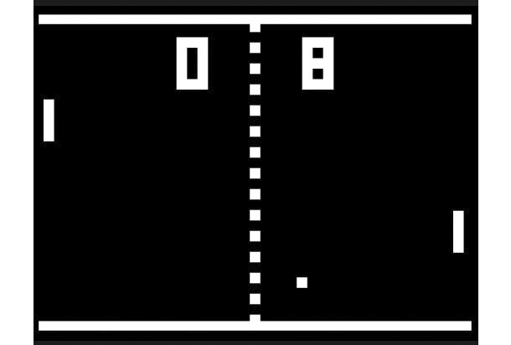
Our Inspiration
The game we will create today is based on the classic video game Pong.
We have also supplied a finished version of our game.

Slide 5
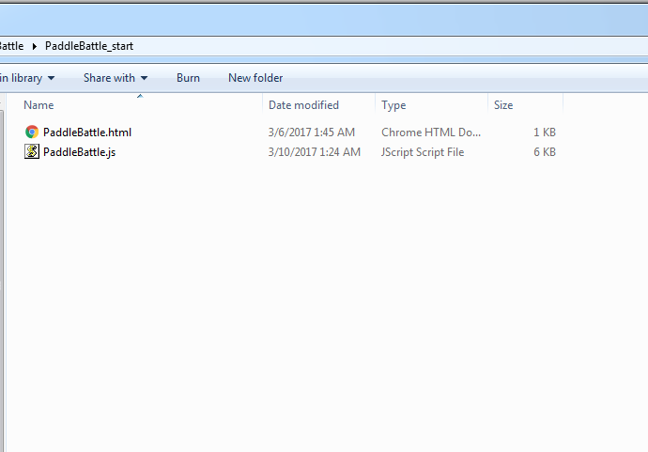
Open the Starter Project
Open up the file browser
Find the PaddleBattle_start folder in the flash drive
The initial setup of the project comes with:
  An HTML file that calls our code, and displays our game
  A JavaScript file that does all the work!

Slide 6
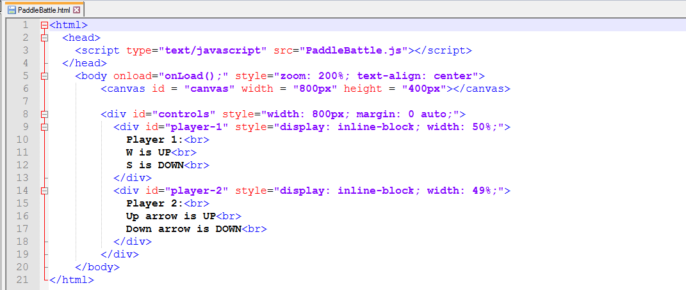
Our Simple HTML File
The canvas element is what we draw our game on
A function named onLoad() is called on the body during the “onload” event
We also have some instructions underneath the game

Slide 7
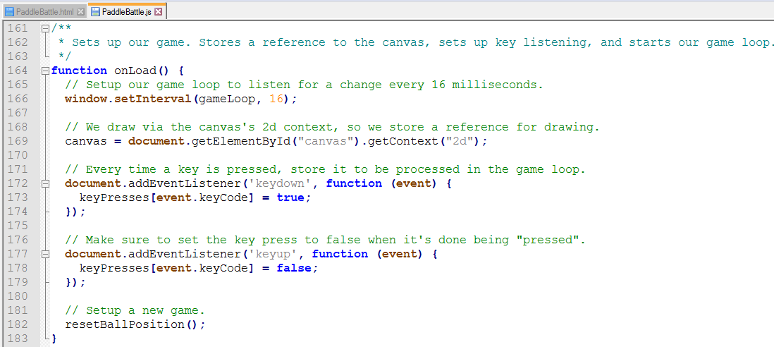
Our onLoad() Event
Open the
JavaScript file
If we scroll to the
bottom, we can
see our onLoad()
function
The onLoad()
function first
initializes our game loop
Then, it takes the canvas from the HTML file, and gets ready for us to draw
The code listens for key presses, and records the unique code
The gameLoop() function calls methods to handle input, update the position of our assets, and draw the game

Slide 8
Let's Draw Something
Find the function called drawGame() under our onLoad() function
The first thing we are going to do is make a black background for our game
We will use a helper function to draw a rectangle
After we have written the code below in drawGame(), open the HTML file in the browser
drawRect("black", BOARD_X, BOARD_Y,
BOARD_WIDTH_PIXELS, BOARD_HEIGHT_PIXELS);

Slide 9
What Does drawRect() Do?
The function drawRect() is a helper function we created to help us write less lines of code
The function takes in the color rectangle we want to draw, the center of our rectangle in (x, y) coordinates, and the width and height of the rectangle
The function calculates the top left corner to draw it on the canvas
/**
* Helper function to take the canvas reference and draw rectangles
* without worrying about the math.
*/
function drawRect(color, x, y, width, height) {
canvas.beginPath();
canvas.rect(x - width / 2, y - height / 2, width, height);
canvas.fillStyle = color;
canvas.fill();
}

Slide 10
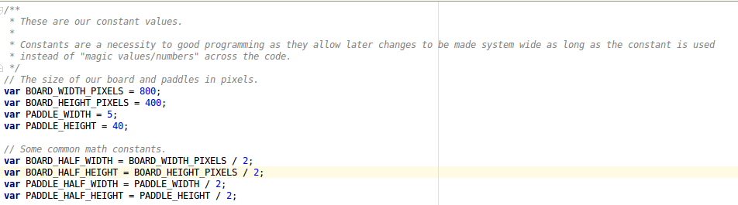
Variables
At the top of our file are a lot of variables
We already used some constants – numbers that never change – to draw our rectangle
Our paddle information is in a game state variable

Slide 11
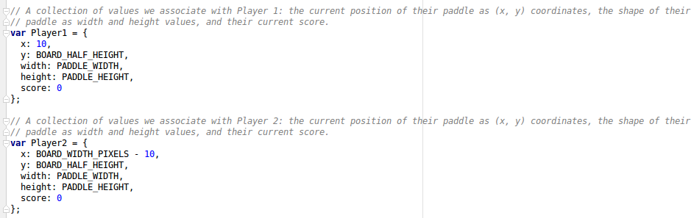
Storing paddle position
We can store a lot of different information under player1 and player2 as properties
The properties help to keep track of where they are on the board, the shape of the paddle, and the score
Our player1 and player2 properties are already loaded with their starting positions
We access the properties like this: player1.x

Slide 12
How to Draw a Paddle
Now that we know where the paddles’ positions are stored, we can write the drawing code!
Under the code we wrote for the game board, we are going to write the two lines shown below
After we write this code, we can refresh our HTML file in the browser
drawRect("white", player1.x, player1.y,
player1.width, player1.height);
drawRect("white", player2.x, player2.y,
player2.width, player2.height);

Slide 13
Drawing the Ball
Our ball is very similar to our rectangle, except instead of giving it the coordinates of the center of a rectangle, we give it the center of a circle and the radius
The ball attributes are also saved in a game state variable towards the top of the file
Along with the attributes that player1 and player2 have, the ball has attributes for its radius, and velocity in both the x and y directions
drawCircle("red", ball.x, ball.y, ball.radius);

Slide 14
Time to Make Things Move
In Pong, we can move our paddles up and down, but never left and right
The next step is to check key presses, and change our paddle position based on that
Before we write our code, we need to review Cartesian coordinates

Slide 15
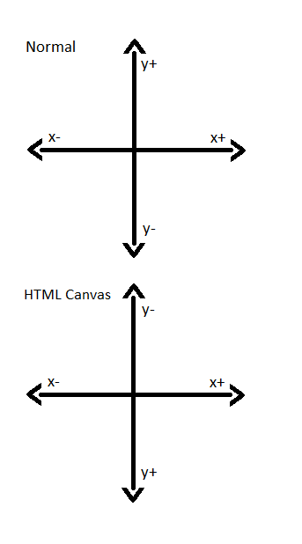
Coordinates - Quick Review
We can move things around on the screen according to x and y positions
Because positive y is downward, when we press down we want to increase our player’s y attribute
When we press up, we want to decrease our player’s y attribute
We don't want our pieces to move left and right, so we won't write any code for those directions

Slide 16
Make Things Move
Go to the handleInput() function above the drawGame() function
We are going to determine which key is pressed, then change our paddle position based on that
Our unique codes for the key presses are already saved for us
  KEY_PRESS_UP
  KEY_PRESS_DOWN
  KEY_PRESS_W
  KEY_PRESS_S
Player 1 will use keys “W” and “S” while Player 2 will use the up and down arrows
We will start with player1’s controls, and move the paddle 4 pixels with every key press
if (keyPresses[KEY_PRESS_W]) {
player1.y -= 4;
}
if (keyPresses[KEY_PRESS_S]) {
player1.y += 4;
}

Slide 17
Moving the Other Player
Our code for player2 is very similar to player1, but with different key presses
Once we add this code, we can refresh our HTML file and test moving both the paddles at once
if (keyPresses[KEY_PRESS_UP]) {
player2.y -= 4;
}
if (keyPresses[KEY_PRESS_DOWN]) {
player2.y += 4;
}

Slide 18
Moving Our Ball
Go to our step() function right under the handleInput() function
We are going to write the code that changes the ball’s position based on its velocity, and bounces the ball off of the walls
First we will start with the y position
We add the velocity to the ball’s position to get its new position for the step
If the ball hits a wall (based on the isOffBoardY() function), then we negate the velocity (which moves the ball in the opposite y direction)
Once we’ve written the code below, we can check our game
ball.y += ball.velocity.y;
if (isOffBoardY(ball)) {
ball.velocity.y = -ball.velocity.y;
}

Slide 19
Bouncing Our Ball
Now we can add the code for moving our ball in the x direction
We have the same logic for adding the velocity to the position to make it move, but now we are checking if the ball bounces off of a paddle
We will use the checkCollision() helper function to check if the ball is hitting the paddle
ball.x += ball.velocity.x;
if (checkCollision(player1, ball)) {
ball.velocity.x = -ball.velocity.x;
}

Slide 20
Play With a Friend!
We made a 2 player game!
Play a game with the person beside you
If the ball flies off the side, you have to refresh the page to get it back

Slide 21
Bouncing Our Ball
We can add the same code for checking if the ball bounces off of player2’s paddle
After we add the code below, we can check it by refreshing our HTML file
if (checkCollision(player2, ball)) {
ball.velocity.x = -ball.velocity.x;
}

Slide 22
Resetting the Ball
When the paddle misses the ball, we need to generate another ball in the center of the screen
Add the code below and refresh the HTML file
if (isOffBoardRight(ball)) {
resetBallPosition();
}
if (isOffBoardLeft(ball)) {
resetBallPosition();
}

Slide 23
Speeding Up the Ball
In the classic game, the ball speeds up every time it bounces off of a paddle
We can increase the speed of the ball slightly by adding 0.5 to the x velocity after a bounce
If our velocity is already negative, then we need to subtract 0.5 to make it faster in the negative direction
if (checkCollision(player1, ball)) {
ball.velocity.x = -ball.velocity.x;
ball.velocity.x += 0.5;
}
if (checkCollision(player2, ball)) {
ball.velocity.x = -ball.velocity.x;
ball.velocity.x -= 0.5;
}

Slide 24
Keeping Score
In the code we just wrote, we can quickly add a line to keep score based on where the ball flew off the screen
If the ball flew off on the right, player1 would score a point, and if it flew off the left, player2 would score a point
Add only the code highlighted
if (isOffBoardRight(ball)) {
player1.score += 1;
resetBallPosition();
}
if (isOffBoardLeft(ball)) {
player2.score += 1;
resetBallPosition();
}

Slide 25
Displaying the Score
Back in our drawGame() function, we can add a quick few lines that will display our player’s scores
We tell the HTML canvas to print the scores slightly off-center (player1 to the left and player2 to the right) and 10 pixels off the bottom of the board
canvas.fillStyle = "orange";
canvas.font = "20px Arial";
canvas.textAlign = "center";
canvas.fillText(player1.score, BOARD_HALF_WIDTH - 40, BOARD_HEIGHT_PIXELS - 10);
canvas.fillText(player2.score, BOARD_HALF_WIDTH + 40, BOARD_HEIGHT_PIXELS - 10);

Slide 26
Keeping Player 1 on the Board
The paddles moves up and down great, except they fly off the board!
We need to add a check for the top limit of the board
We need to update our code to check if y is off the board – if it is, it will just stay at the lowest allowed value
Add the code highlighted in yellow
if (keyPresses[KEY_PRESS_W]) {
player1.y -= 4;
if (isOffBoardTop(player1)) {
player1.y = PADDLE_TOP_LIMIT;
}
}

Slide 27
Keeping Player 1 on the Board
We need to repeat our code change for the “S” key
Now we check to see if y is off the board in the other direction, and if it is, we keep it at the highest allowed value
Add the code highlighted in yellow
Let’s refresh our HTML file and see our code working!
if (keyPresses[KEY_PRESS_S]) {
player1.y += 4;
if (isOffBoardBottom(player1)) {
player1.y = PADDLE_BOTTOM_LIMIT;
}
}

Slide 28
Keeping Player 2 on the Board
Now that we know that change worked well, we can copy it over to player2
Add the code highlighted in yellow, and always check your work after a change!
if (keyPresses[KEY_PRESS_UP]) {
player2.y -= 4;
if (isOffBoardTop(player2)) {
player2.y = PADDLE_TOP_LIMIT;
}
}
if (keyPresses[KEY_PRESS_DOWN]) {
player2.y += 4;
if (isOffBoardBottom(player2)) {
player2.y = PADDLE_BOTTOM_LIMIT;
}
}

Slide 29
Polish the Game - Paddles
Our paddles still slide too far off the game board – we can fix that by updating our code in the highlighted area
This only shows the change for player1’s UP button
The same type of change needs to be added for player1’s DOWN and player2’s directions
if (keyPresses[KEY_PRESS_W]) {
player1.y -= 4;
if (isOffBoardTop(player1)) {
player1.y = PADDLE_HALF_HEIGHT;
}
}

Slide 30
Steps to Finish Your Game
Finish updating the paddles so they stay inside the board
Draw a green line above and below the board
Draw a dotted line down the middle of the board
Update all of the math to account for the extra green lines on the top and bottom of the board
Please keep an eye on https://github.com/hillylew/PaddleBattle for additions to this tutorial

Slide 31
Thank you!
Included on your flash drive are the following programs
  Notepad++ – a text editor with syntax highlighting, good for writing code
  Gimp – A free and open source image editor
  Audacity – A free sound editing program
  Reaper – A digital audio workstation program providing convenient licensing
  Blender – A free and open source 3d modeling tool
  Tiled – A free and open source Tile Map editing tool, used for creating complex levels
Please visit https://github.com/hillylew/PaddleBattle for future updates to this project or to help in its development. Paddle Battle is a GPL'd open source project that anyone can contribute to!
We hope you enjoyed Paddle Battle!

